Slide 1
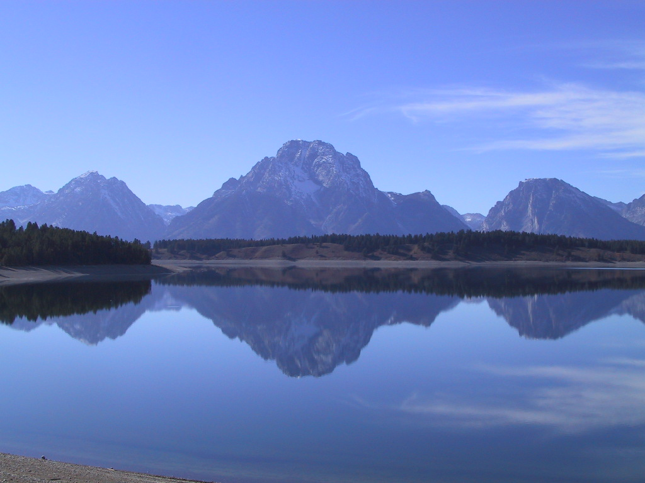
Environmental Flow Management Effectiveness in Lakes and Rivers
A Look at State and Provincial Fish And Wildlife Agency Efforts
Notes:
This presentation looks at what other states and Canadian provinces are doing in terms of strategies and effectiveness and drawing from that information offers ideas about ways to do a better job of securing environmental flows.

Slide 2
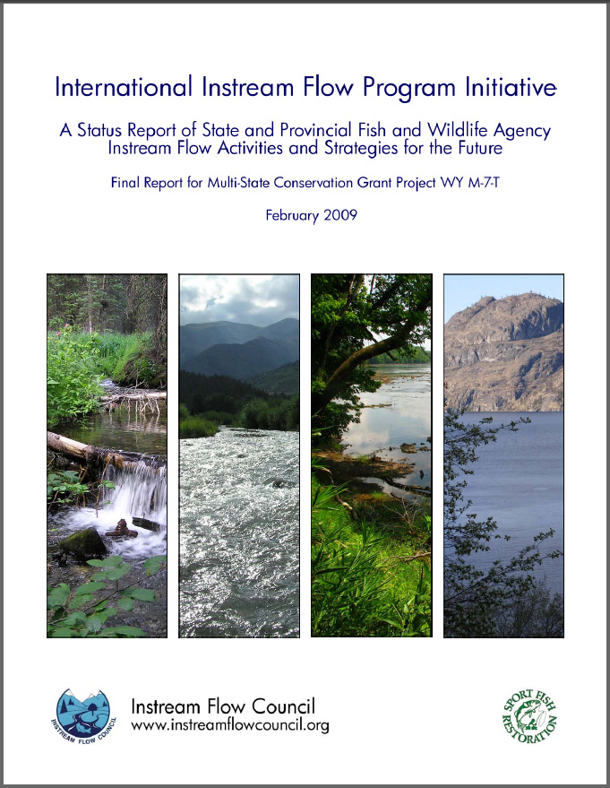
Alabama’s Existing Instream Flow Program
Notes:
The information referenced throughout this presentation is drawn from two detailed surveys that were conducted by the Instream Flow Council between 2006 and 2008. Some of the information provided during that survey may have changed, but it is likely that the general trends recorded across the U.S. and Canada are much the same now as they were when the surveys were done.

Slide 3
Instream Flow Program Initiative
Focus was on state and provincial (Canada) Fish & Wildlife agencies (IFC members)
Funded with Federal Multi-State Grant
3-year duration (2006-2008)
All 50 states (and 6 provinces) participated
Tied to concepts and policies of IFC’s book
Notes:
The focus of this study was to help IFC member agencies identify the factors that were limiting their effectiveness for managing water for fish and wildlife and identify strategies that might improve that effectiveness. Only state and provincial fish and wildlife agencies (IFC member agencies) were included in the survey.
The U.S. Fish and Wildlife Service office of Federal Assistance awarded IFC a grant for the project effective January 1, 2006. This was a 3-year project slated to end in December of 2008. The project wound up being extended an extra 6-months to allow the final report to be written. Participants in the survey included all 50 states and 6 of the 12 Canadian provinces and territories. Most of the survey questions for the project were derived from concepts and policies in the IFC book Instream Flows for Riverine Resource Stewardship.
3

Slide 4
Project Goal
… (identify) trends and opportunities that will help state and provincial fishery and wildlife management agencies develop, maintain, or improve the effectiveness of their instream flow/water management activities and programs.
Notes:
This project was designed to be outcome driven – we wanted to be able to clearly articulate the things that make agencies effective when it comes to managing water resources for fish and wildlife. It’s important to note that not all agencies have formal instream flow programs so this goal relates to any aspect of agencies’ involvement in water management.
We found it very interesting the number of fish and wildlife agencies that had a hard time thinking that they should have anything to do with water management in spite of the fact that it is the most important factor that affects the fish and wildlife resources they are charged with managing. “We manage fish, not water” was an all-too-common reply from participants.
4

Slide 5
Project Elements
* - Based on self-evaluations
2006-2007: Agency surveys*
  Part 1: Comprehensiveness of water program
  Part 2: Effectiveness of water program
October, 2007: Post-survey workshop
2008: Final reports
Notes:
The primary elements of the project included two web-based surveys, a post-survey workshop and final reports. It is important to note that the surveys were self-evaluations using questions provided by IFC. Because there were essentially 56 different data recorders there are practical limits to comparing the results from each participant to each other. As a result, individual agency results were not published in the final report – but were given to each participant to share with others at their discretion.
Of the two surveys, the first was focused on determining how comprehensive each participant’s agency was in terms of their compliance with IFC policies on environmental flows. The second survey was designed to address the effectiveness of each agency’s water management program or activities in terms of a range of elements that were common to all agencies as determined by the planning committee.
5

Slide 6
Survey 2 – Agency Effectiveness
Logic model
  Inputs (resources you need)
  Activities (what you do)
  Outputs (what things you get done)
  Outcomes (so what)
Notes:
This presentation is drawn primarily from the second survey that looked at agency effectiveness. This part of the survey was based on a logic model developed by the planning committee to help generate questions. For our purposes, the model included 4 main categories of information – Inputs, Activities, Outputs, and Outcomes.
6

Slide 7
Begin with the end in mind – identify outcomes first
Notes:
In order to know what questions to ask, we needed to know where we wanted to end up. So we identified the Outcomes first. As noted by many planners it’s always a good idea to begin with the end in mind.

Slide 8
Example of Logic Model Format (identify the target, then develop a road map)
Inputs / Resources | Activities | Outputs | Outcomes
Budget | Permit review | Scientifically valid flow/volume recommendations or conditions | Functional environmental flows
Information/Data | Water right filings Conduct field studies | Enforceable water quantity and quality protections | Flow-supportive laws and policies
Staff | Interdisciplinary coordination | Effective partnerships | Knowledgeable and actively involved public
Notes:
This matrix shows the general format of our logic model. We began by identifying the range of outcomes we felt were important for most fish and wildlife agencies. These included not just what the streams should look like, but also the need to have supportive laws and policies as well as a knowledgeable public that is actively supportive of environmental flows.
From that point we could ask questions about related budgets, staff, training etc. and then move on to learn about Activities and Outputs of agencies.

Slide 9
Survey results
Inputs / Resources
Notes:
We’ll start by looking at what resources or inputs most state and provincial fish and wildlife agencies have to work with. The majority of questions we asked focused on Inputs and Activities.

Slide 10
Institutional Framework
Recognizing water in planning documents
Notes:
For any agency to effectively manage flow for environmental purposes it’s important that they at least recognize the importance of water as a habitat component in their mission statement or strategic plans. According to the IFC survey this is generally more common in the western and midwestern parts of the US than it is in the East.

Slide 11
Institutional Framework
Agency structure
Notes:
Formal instream flow programs are actually more rare than one might expect among survey participants. Relatively few states in the eastern U.S. and Canada have formal programs, however the majority (6 of 9) western states have some semblance of a formal crew doing instream flow related work. Flow work in the east tends to be shared among people in various organization units which raises some question about the consistency of their effort.

Slide 12
Institutional Framework
The role of water management when setting priorities
Notes:
Fish and wildlife agencies prioritize their efforts in lots of ways and it would seem that understanding the availability of water and need to better manage it for the organisms an agency is charged with managing would be logical. However, the survey showed that very few agencies actually use water availability as a basis for directing where they do work to protect riverine resources and environmental flows.

Slide 13
Notes:
In virtually every state, the most needed tools to help manage environmental flow was more supportive regulations and policies, water management staff to implement those policies, more actively supportive public and better laws.
Most states think their staff is able to recognize needs, they just don’t have a vehicle to act on their knowledge.

Slide 14
Top five needed resources:
More staff
More supportive laws
More knowledgeable public
More actively supportive public
More supportive regulations and policies
Not more or better scientific methods
Notes:
Here’s the list of the top 5 inputs participants requested summarized from the preceding figure. As noted, agencies tend to need more staff, a more knowledgeable public, a more actively involved public, better regulations and policies and better laws. What’s equally important to note was what participants didn’t say they need more of, which includes more or better instream flow quantification methods.

Slide 15
Inputs
What methods should you use?
What’s everyone else doing?
Notes:
A question that always is at the top of everyone’s need-to-know list is what the best method(s) is/are for a particular purpose or project. Similarly, there’s always a desire to know what other states are using.

Slide 16
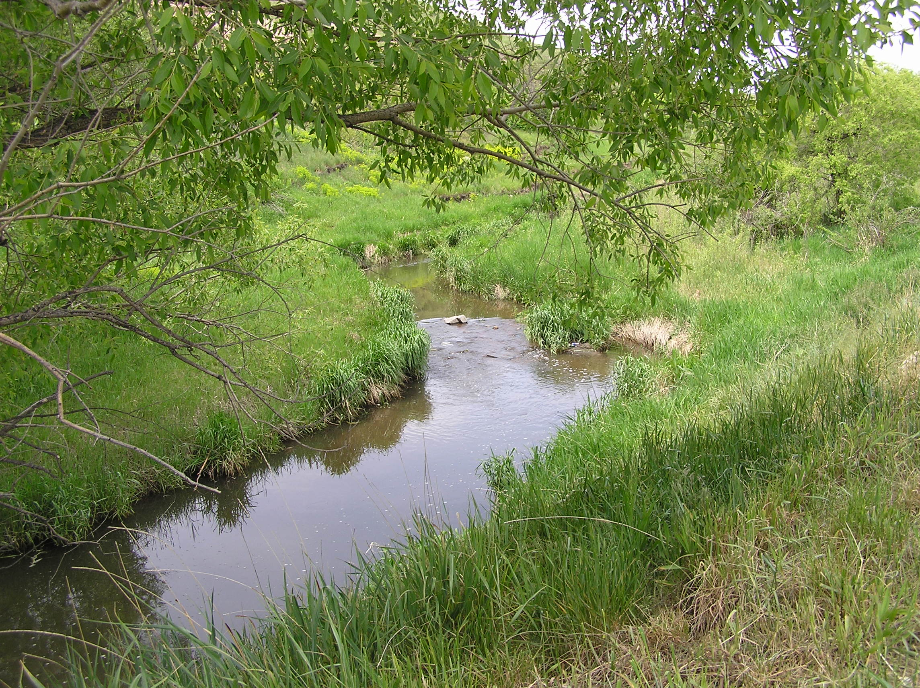
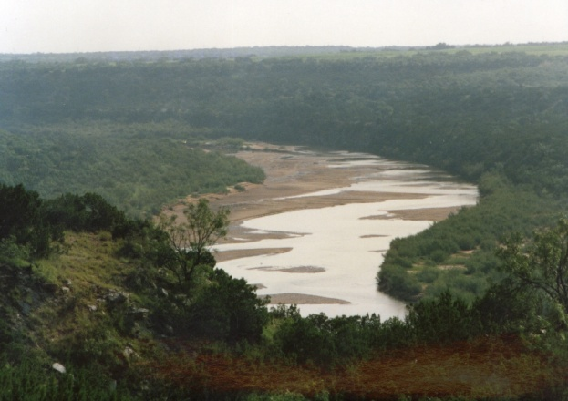
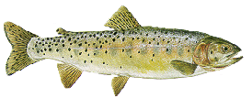
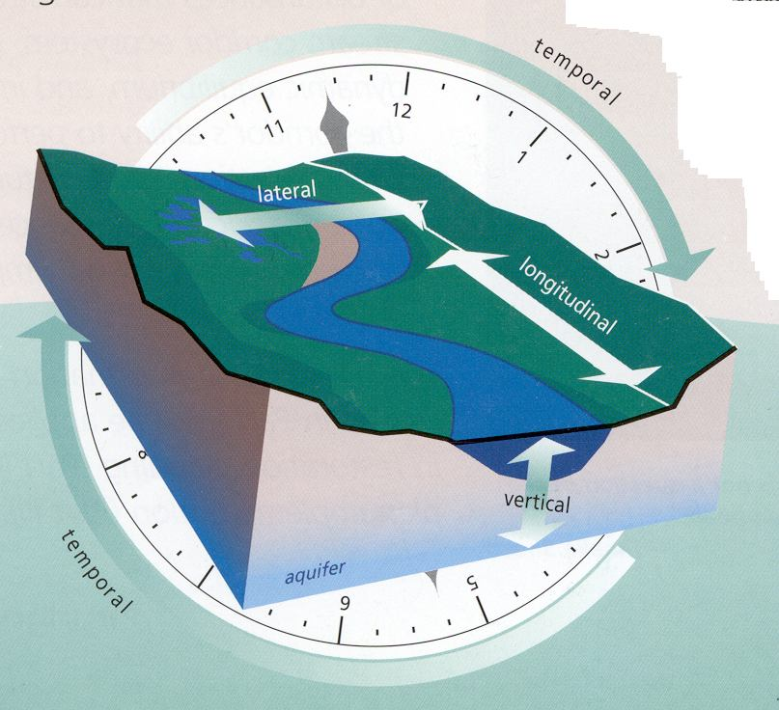
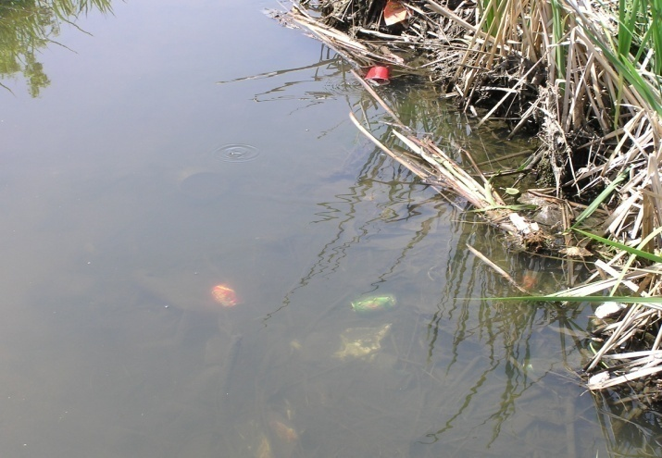
Geomorphology
Biology
Hydrology
Connectivity
Water Quality
Notes:
Remember we have at least five general areas of scientific interest that define the nature of rivers. So in theory you should at least consider a methodological approach that addresses each of these areas – or explain why you don’t need to address a particular discipline.

Slide 17
How limited are agencies to select methods?
Notes:
Before getting to the question of what agencies are using to quantify flow needs, we wanted to know whether state and provincial fish and wildlife agencies were able to use any method they wished or if laws and policies constrained their tool selection. As this graph shows, most participants are free to use any method they wish, the exceptions being a few states in the Southeast US where they have been limited to very conservative tools like 7Q10 – and the Western US where some states are required to use PHABSIM for analyses. This information is key when we consider the need to incorporate a wide variety of information and the availability of many flow quantification tools. Unfortunately this freedom to use whatever model we wish, isn’t acted on very aggressively by fish and wildlife agencies.

Slide 18
What methods do most state and provincial agencies use?
Notes:
To determine what methods survey participants were using we asked about each of the five riverine elements – Hydrology, Biology, Geomorphology, Connectivity, and Water Quality.

Slide 19
Biology Methods Used
Notes:
Of the many methods available to quantify flow needs based on biological attributes, three methods stood out. PHABSIM, Tennant, and wetted perimeter methods are some of the older methods available and it appears that they are still the most commonly used tools. Two-dimensional hydraulic models have gained prominence in the past 5-10 years and appear to be slowly working their way into the mainstream of biology methods used. The numbers in this graph relate to actual responses so it is noteworthy that only 18 of the 56 respondents use the most commonly used method.

Slide 20
Hydrology Methods Used
Notes:
There are basically two hydrology methods that are very widely used by survey participants but their use is not very significant in terms of total states and provinces participating in the survey. These methods have been used fairly commonly by other individuals and entities such as The Nature Conservancy and consulting companies. Though these tools have been used extensively by others, most state agencies haven’t availed themselves of these tools very much.

Slide 21
Geomorphology Methods Used
Notes:
There are several methods available to quantify the amount of flow needed to maintain geomorphological processes. Some of these can be fairly technical such as the HEC models. So it’s not surprising to see that very few fish and wildlife agency participants have done much with these models. We did see a relatively high number of participants who indicated they had used a Geomorphic Classification System, however this tool is not usually very useful for quantifying environmental flow needs. It’s designed more as a descriptive tool to describe the geologic condition of streams than it is to prescribe a particular flow condition. Still, it’s clear that most states and provinces don’t do much with this class of models to quantify or manage instream flow regimes.

Slide 22
Water Quality Methods Used
Notes:
Methods to identify the amount of water needed to maintain adequate water quality for riverine resources have been around much longer than quantitative habitat methods. However very few participants use any water quality methods to quantify environmental flows for fisheries. This is probably because water quality management is often managed by completely separate agencies that fish and wildlife agencies. Still, the fact that 7Q10 is used by four survey participant agencies is troublesome.

Slide 23
Reservoir Methods Used
Notes:
In spite of the many reservoirs that have been created across North America and the amount of effort that fish and wildlife agencies invest in managing fisheries in those water bodies, we found that very few agency programs use any methodology at all to assess the water volume needs of reservoirs for fisheries. Only 1 agency (Wyoming) has done anything approaching a quantitative analysis (Reservoir Quality Index). The Demonstration Drawdown technique is a relatively subjective tool that draws on the opinions and professional judgment of scientists – though such information can be just as valuable as more quantitative tools.

Slide 24
Holistic Methods Used
Notes:
In spite of the recent development of several holistic environmental flow methods in the US and around the world, we found that very few state or provincial fish and wildlife agencies avail themselves of those tools. Not surprisingly, the most commonly used holistic method was the Instream Flow Incremental Methodology but it was only used by 11 of the 55 survey participants who answered this question. And of those it seems at least possible that the participant may have confused the multi-disciplinary scope of IFIM with the much simpler component of that methodology – Physical Habitat Simulation (PHABSIM). The only other tool that has been used very much by state fish and wildlife agencies is the Demonstration Flow Assessment.

Slide 25
Why don’t more agencies address all 5 riverine elements?
Traditional emphasis on “just fish”?
Lack of awareness of other tools?
Lack of training to use other tools?
Lack of staff to do more?
No one told us to?
It’s NOT because laws and policies prevent doing so
Notes:
Why don’t more state and provincial fish and wildlife agencies incorporate all 5 riverine elements in their water management activities? We didn’t ask this question directly but if you look at responses for various questions you get a sense of what’s going on. Unofficially, one might guess that our traditional emphasis on looking at just fish is at the bottom of this. An associated reason is that, because we’ve focused so exclusively on fish, many biologists simply aren’t aware of the opportunity or need to use other tools. It’s probably also related in some measure to a lack of training, staff and budgets to do any more than the minimum level of effort needed for any one situation. Of course the easiest answer of all that’s probably not too far off the mark is that no one told us to do more. As we saw in a previous slide, however, this lack of methodology selection is not a function of restrictive laws and policies. If agency participants wanted to use more methods they apparently could.

Slide 26
Coordination With Other Entities
Other State Agencies
Federal Agencies
Local Agencies
Tribal Groups
NGO’s
Universities
Individual Water Users
Water User Groups
River Basin Groups
Policy Makers
K-12 Schools
Civic Organizations
Notes:
Effective environmental flow work involves coordinating with a variety of other interests. We identified 12 of the main groups that state and provincial organizations often coordinate with.

Slide 27
Is there sufficient coordination and/or partnering with other entities?
Notes:
Overall, participants tended to think they coordinate enough with the feds and some non-governmental organizations. But they appear to feel they could do a much better job coordinating with local agencies, water users, legislators and educational groups. Environmental flow management is a complex business that requires a lot of work to explain the basis and need for effective water management to the others.

Slide 28
28 Flow-Related Activities
Reservoir management agreements
Endangered Species Act
Dam removal
Wild & Scenic Rivers
Hydro licensing
Notes:
We identified 28 different activities that agency personnel commonly use to secure environmental flows. These include things like work with federal or state endangered species acts, reservoir management agreements, dam removal, hydro licensing and re-licensing, and federal or state wild and scenic rivers legislation There is much more information here than can be easily read but the take-home message is that there are indeed many ways to manage water. We note that the thing to focus on is not the tool but the result. If we’re going to use a tool we need to know how effective it is to achieve adequate environmental flow protection for the target resource. So we asked follow-up questions related to the adequacy of each tool.

Slide 29
What level of protection do these provide?
All 28 provide at least base flow protection in some states and provinces.
Few are capable of providing full or partial ecosystem flow protection
Notes:
All of these activities provide at least Threshold levels of protection in most jurisdictions. But not many are effective for realizing full or even partial flow protection.

Slide 30
Provide Full Flow Protection
Notes:
If you look at which strategies have afforded states the ability to secure full ecosystem protection, you can see that none of these strategies is a sure-fire tool for achieving that condition. For example only 4 participants indicated that the U.S. Federal Endangered Species Act was an effective way to achieve full ecosystem protection. Achieving this standard of protection on any stream or river is indeed a very daunting challenge for almost all fish and wildlife agencies.

Slide 31
How do agencies spend their time?
Notes:
This graph illustrates how participants spend their time and how they think they should allocate their time. What’s interesting here is not necessarily the specific elements, since every jurisdiction has a somewhat unique list of their top activities. The more interesting thing to note is the fact that so many people thought they needed to spend more time doing just about everything. Only 3 individuals in the survey thought they spent too much time doing anything. An important message from this graph is that it shows just how many things instream flow managers need to work on – and typically this list of work items is handled by a single individual (or small group) within an agency. Such a work load limits the effectiveness of water management by agencies and reinforces the need for agencies to retain full time staff dedicated to instream flow and water volume management.

Slide 32
Outputs
Notes:
So what do the states and provinces have to show for their efforts? What Outputs or protections have they achieved?

Slide 33
Most states reported less than 25% of streams in unaltered condition
In some states less than 5% of streams are unaltered
Alaska and Canada had the most streams in unaltered condition
Notes:
In most parts of the country, fewer than 25% of all streams are in unaltered condition today. And in some parts of the US the number is less than 5%. Only in Alaska, parts of Canada and some northeastern states can you find a majority of streams in unaltered condition.

Slide 34
Over 50% of participants said 0% of streams had Full Protection
One-third said only 1-5% of streams had Full Protection
Nearly half of participants said >76% of streams had No Protection
Notes:
Very few streams in the US and Canada have Full flow (ecosystem) protection. Over half of all participants indicated that 0% of the streams in their state or province have that level of protection while one-third of participants indicated that 1-5% of the streams in their jurisdiction had Full flow protection. The same general trend holds for the next highest level of flow protection.
On the other end of the spectrum almost half of all participants indicated that over 76% of the streams in their state or province had no protection at all.

Slide 35
Outcomes

Slide 36
Notes:
When we asked participants what their vision of the future was, the majority thought the condition of rivers and lakes would remain about the same or deteriorate in the next 10 years. However when it came to their outlook for the existence of effective environmental flow laws and the role of the public their outlook was somewhat brighter. This is an interesting twist – that participants anticipate better laws and a more involved public but don’t seem to think that these factors will make much difference overall for the health of the country’s rivers and lakes.

Slide 37
Southeastern States E-Flow Status
(institutional capacity, legal authority, public involvement, protected streams)
North Carolina
South Carolina
Florida
Tennessee
Virginia
Kentucky
Arkansas
Louisiana
Texas
Oklahoma
Mississippi
Georgia
Alabama
Instream Flow Council survey, 2009
Notes:
None of the 13 southeastern states in our study afford environmental flows the same status or level of opportunity as are afforded to consumptive water rights. But in comparison to these states in terms of legal capacity, institutional support, public involvement and stream protection effectiveness, Alabama ranks last. It is important to note that the quality of responses from each participant may differ so the precise order of this list may not be totally accurate. However the relative position of states does appear to be reasonable and Alabama is most likely near the bottom of this list in terms of opportunities and accomplishments among southeastern states. It’s also important to bear in mind that this survey was conducted in 2006-2008 and things may have changed since then. Regardless, there is much room for improvement in every state we surveyed, but those opportunities are especially ripe in Alabama.

Slide 38
Why the low rank?
Legal capacity
Institutional capacity
Public involvement
Resource protection status
Notes:
Considering that survey participants answered over 200 questions in two different surveys there is plenty of information to explain why state agencies ranked where they did – and reveal why Alabama ranked where it did.

Slide 39
Legal Capacity
There are no laws related to instream flows .
Laws do not allow protection of any amount of water in new or existing reservoirs.
Policies allow comprehensive ecological protection or full instream flow protection.
Policies do not allow protection of any amount of water in new or existing reservoirs.
Instream Flow Council survey, 2009
Notes:
The model we used to score each agency’s response was based on criteria common to all participants. For legal capacity we considered each participant’s authority under both law and policy for the four areas shown in this slide.

Slide 40
Institutional Capacity
Water management may or may not be recognized in planning documents / Work is assigned if need arises but that's not often.
Agency has met no more than one of the following: adequate administrative staff, adequate training, adequate budget, access to technical staff, well functioning organizational structure.
Agency has access to experts in only two of the following disciplines: hydrology, biology, geomorphology, water quality or connectivity.
Instream Flow Council survey, 2009
Notes:
Likewise our ranking model established five narrative levels of effectiveness related to their institutional capacity or effectiveness.

Slide 41
Public Involvement Capacity
Exhibit 1 of the following 3 features: knowledgeable public OR have active public OR have access to agency I&E personnel.
Have sufficient coordination with 4-6 public entities active in water management issues
There are at least 2 other groups or agencies doing advocacy or education on instream flow issues.
Instream Flow Council survey, 2009
Notes:
Public involvement capacity was similarly ranked on five narrative levels of activities and was an area that Alabama could improve on as well.

Slide 42
Resource Protection Status
< 25% of miles of streams in unaltered condition.
Over 75% of all stream miles have no flow protection
No stream miles have full ecosystem protection.
Instream Flow Council survey, 2009
Notes:
Like most southeastern states, Alabama ranked low in the number of streams protected with instream flow and with the level of protection on those streams with some instream flow status.

Slide 43
Participants from southeast region identified three primary agency drivers
There needs to be a strategic vision and plan for the future instream flow program in each state.
There needs to be policy, law, and rules for instream flow programs. Instream flow is not, a recognized beneficial use in some states.
The public isn’t fully aware or supportive of instream flow values, e.g. agencies haven’t communicated well enough with stakeholders
Instream Flow Council survey, 2009
Notes:
A significant element of this project was a workshop held in October 2008 in Denver, Colorado. The project offered funding to all survey participants to attend this gathering and the majority did attend. The purpose of this meeting was to take all of the information obtained in the surveys and use it to craft realistic strategies to address regional and agency needs. This image shows the top 3 drivers identified by all those present from the southeast region. From these drivers, specific strategies were developed.

Slide 44
Region-Wide Strategies
Develop strategic plans that contain a vision for the future related to instream flow.
Commission comprehensive water law studies; Find and reference a model law.
Hire marketing firms to help craft the message, identify the audience, and develop a marketing plan to promote establishment of instream flow laws.
Instream Flow Council survey, 2009
Notes:
The southeast region identified 17 realistic strategies for dealing with the top drivers. This image shows the top strategies for each driver.
The complete list as well as detailed information on the entire project can be found in the final report for the project. Copies of the report can be downloaded for free from the Instream Flow Council web site
(www.instreamflowcouncil.org) or contacting IIFPI project manager Tom Annear at Wyoming Game and Fish Department, 5400 Bishop Blvd., Cheyenne, WY 82006.

Slide 45
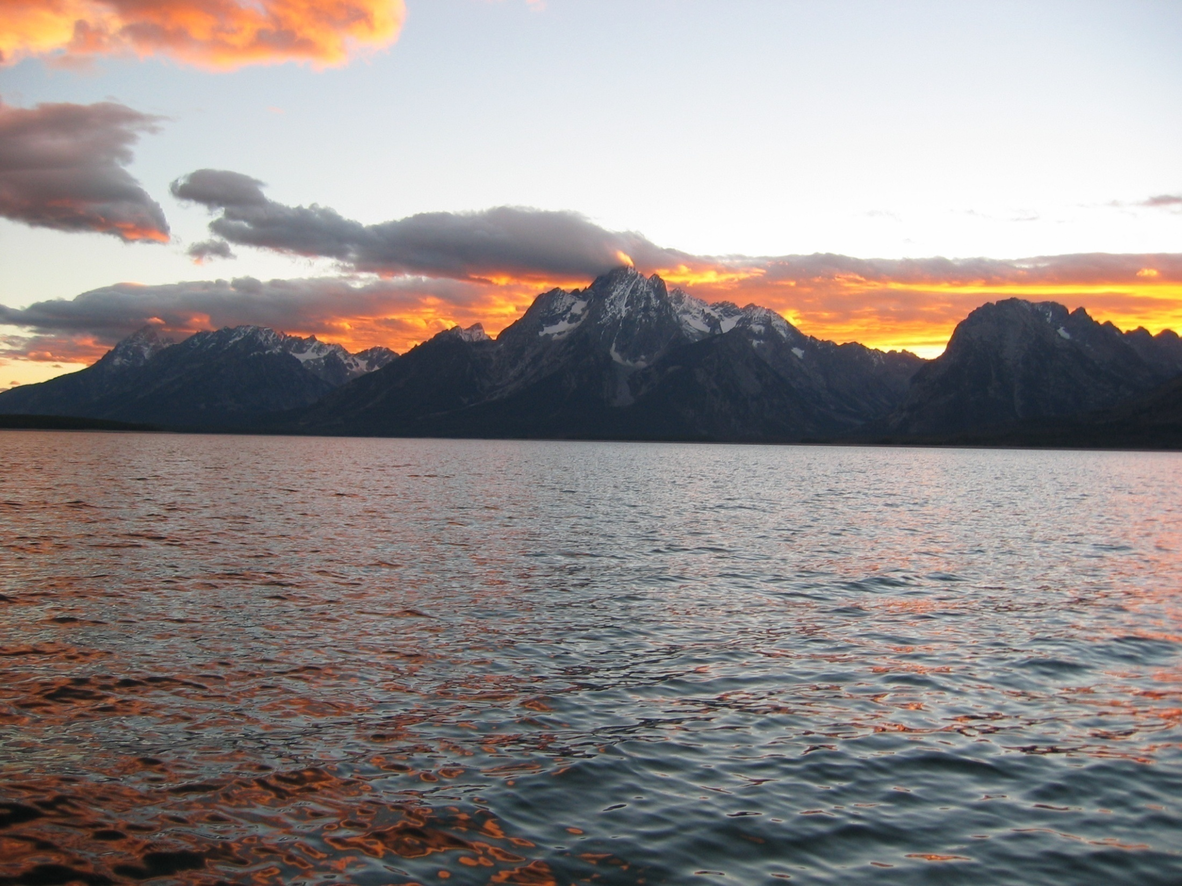
Where to from here?
Start where you are
Stay the course
Notes:
It doesn’t do any good to wish things were different than they are. Nor is it productive to take a position that rivers and lakes are so degraded from their natural condition that there’s not much left to work with. The fact is that whatever resource condition you have now, it’s the new normal and standard from which to begin protecting and restoring. In the water world, change never happens quickly. So for the sake of present and future river and lake beneficiaries, it’s necessary to start where you are and stay the course for as long as it takes – and then hand off the job to the next generation of river and lake managers.

Slide 46

Anything else you’re interested in is not going to happen if you can’t breathe the air and drink the water. Don’t sit this one out. Do something. You are by accident of fate alive at an absolutely critical moment in the history of our planet.
Carl Sagan, astronomer

